Slide 1
Fenelon Falls
Second Crossing:
Municipal Class Environmental Assessment
Public Information Centre #3 May 29, 2021
Notes:
Rory - introductions

Slide 2
Agenda
Item
1. Overview of Work Completed
2. In-Town Traffic Improvements
3. EA Options Review
4. Summary of Recommendations
5. Next Steps
6. Q&A
We are recording the presentation to be able to post on the project website.
Notes:
Rory

Slide 3
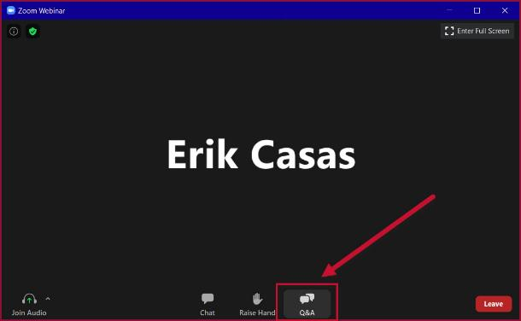
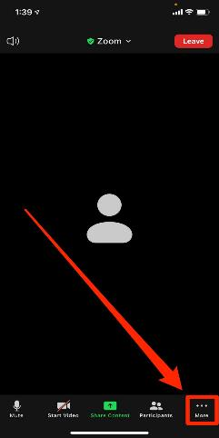
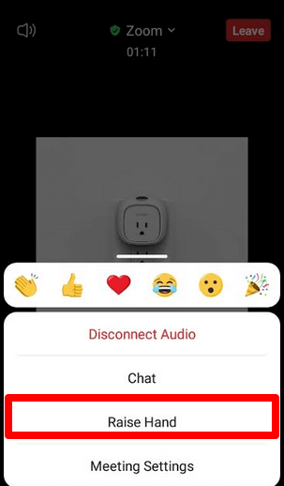
Q & A
During the Q&A period, for those on the Zoom meeting link, please enter your questions into the Q&A box or raise your hand using the raise hand function found at the bottom of the screen. We will repeat these instructions during the Q&A period.
Name
If calling in on telephone, press *9 to raise your hand
Notes:
Rory

Slide 4
Purpose Meeting
Present information on work completed
Present input from consultation with stakeholders and the community
Present preliminary recommendations for discussion
Address questions
  Thank you to those who sent questions in advance of the meeting today. We have tried to answer many of the questions through presentation materials. Will have time for further discussion and questions after the presentation.
Following this meeting, comments can be submitted up until June 15, 2021. A summary report including public input will be provided to Council.
Notes:
Merrilees

Slide 5
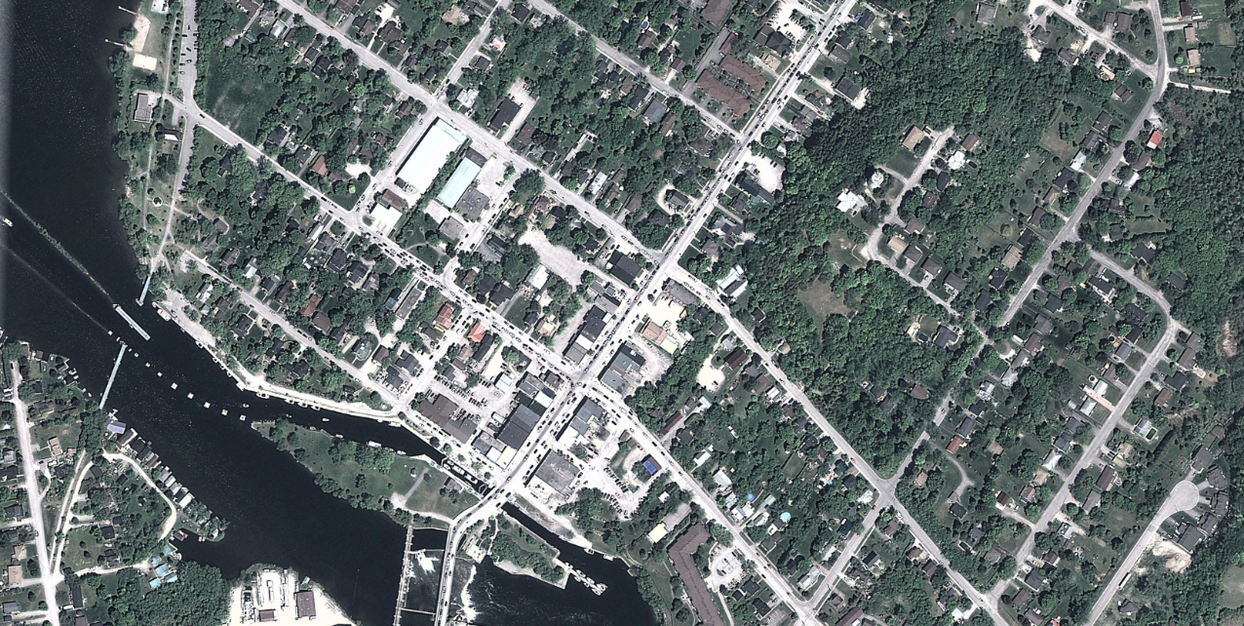
Problems and Opportunities
Key Problems
Congestion and traffic delays
Bridge back-up
Helen and Lindsay Street intersection at capacity by 2031
Main street experience
Business impacts and parking
Traffic and land use, e.g., Tim Hortons, Sobeys
Key Opportunities
Reduce delays and traffic congestion
Improve main street experience
Improve connectivity
Support Downtown Revitalization Plan
Improve relationship between land use and transportation

Slide 6
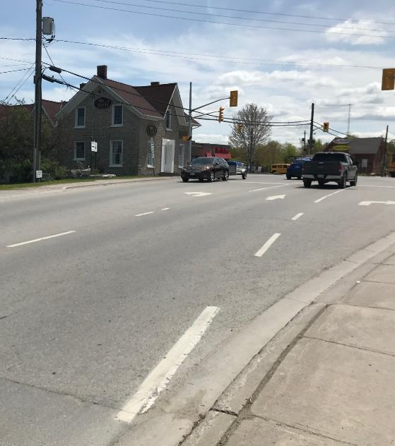
Core Issues
  Traffic volume during peak periods
    Increase in vehicles during summer peak periods contributes to congestion along the main corridor (primary concerns are May – September)
  Traffic flow at Helen Street and Lindsay Street intersection
    Existing configuration and travel demands of intersection creates a bottleneck
  Limited alternative routes in the area

Slide 7
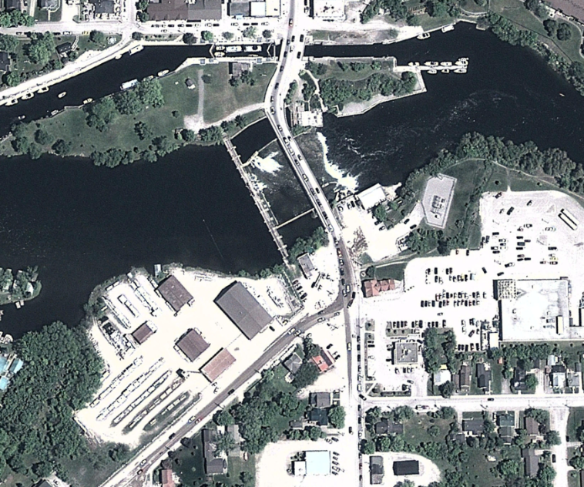
Intersection Issues
At capacity: Downtown Corridor Study shows Helen/Lindsay St intersection will be ‘at capacity’ by 2031.
Land use: the Tim Hortons and Sobeys, and the gas station cause traffic flow issues at the intersection. Largest contributor to traffic issues is the southbound left turn into the Sobeys and Tim Horonts lots.
Queues: not enough storage for vehicles waiting to turn = significant queues. Particularly southbound left turn which affects bridge.
Sobeys
Tim Hortons
Access Control: Gas station access on the west side of Lindsay St causes additional delays from northbound left turns.

Slide 8
What We Have Studied
Transportation and Traffic Studies
  Updated traffic data analysis – local and regional (Using Streetlight Data and Intersection Traffic Cameras)
Environmental Conditions
  Aquatic and terrestrial (woodlands, wetlands, waterbodies)
Socio-Economic Conditions
  Properties, people and businesses
Cultural Heritage and Archaeology
Technical Design Engineering
  Topography, property, utilities, road and bridge design

Slide 9
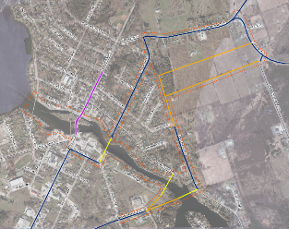
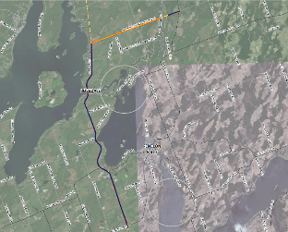
Options Considered
In-Town Area
Do Nothing
Improve local traffic operations
Expand existing bridge
Build second in-town crossing
Build a bypass: 3rd Concession Baddow
  Note: Other bypass options reviewed including existing bridges Northline/Poulsom and Concession 6/Burnt River Road
Bypass Area

Slide 10
Updated Traffic Study – Streetlight Data
We did a traffic study of current traffic in Fenelon Falls using Streetlight Data and intersection traffic cameras
  Streetlight data uses GPS and cell phone data – used to understand travel patterns of automobiles that cross the Fenelon Falls bridge (anonymous data)
  Looked at traffic all days of the week and during summer peak seasons
Found that most vehicle trips that use the bridge originate from within a relatively local area. Around Sturgeon Lake and Cameron Lake.

Slide 11
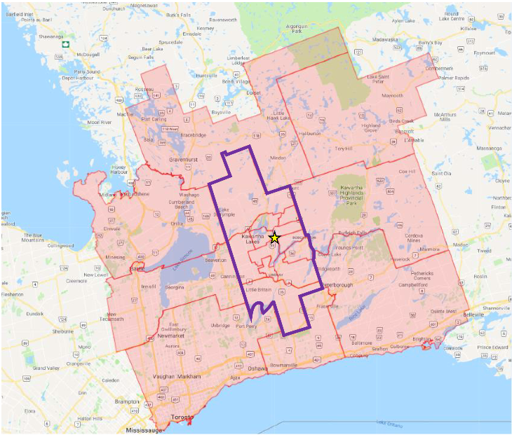
Traffic Data Analysis
For vehicles crossing the bridge:
Majority of trips (>70%) are within the City of Kawartha Lakes
Up to 20% of trips are between Kawartha Lakes and External Areas
35% - 39% of trips travel from north to south and south to north
47% - 51% of trips are between areas south of the bridge

Slide 12
Traffic Study Summary
Need to address some of the traffic operation issues in-town
Support for some in-town improvements with traffic diversion:
Approximately 20-30% of traffic could be diverted around town
Approximately 40-50% of traffic could be diverted on a second in-town bridge crossing.

Slide 13
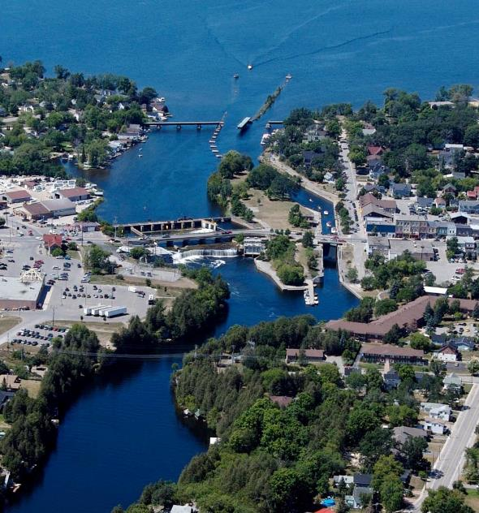
Traffic Improvements
Why are traffic improvements proposed?
Land use and traffic operations at intersection of Helen and Lindsay Streets is primary issue.
Sobeys and Tim Hortons expected to remain for the foreseeable future.
Opportunity to rethink how site access is provided and management of turning movements.
Traffic improvements can be progressed immediately.

Slide 14

Traffic Operation Improvements
The traffic improvement options for the Helen Street and Lindsay Street intersection examined were:
Signal Changes
      Optimising Signals
      Provide new left turn signals
Access Control
      Tim Hortons / Sobeys / Gas Station
Additional Capacity
      Extend Storage Lanes
    Restrict Movements
      Limit turning movements
  Potential to explore relocating some land uses to improve traffic flow and access
The Consulting Team studied more than 25 options.
Notes:
Ian

Slide 15
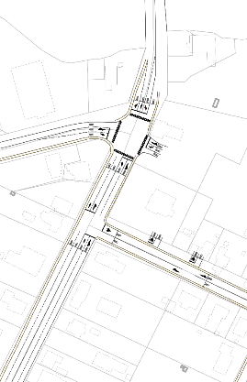
Traffic Improvements
Bridge
Signal Changes Alone Not Recommended
2031 traffic volumes cannot be accommodated at intersection in current design.
  Green-time can be adjusted to favour a particular movement but causes problems elsewhere (Southbound (SB) vehicle queues improved, but with additional queues on NB and EB approaches)
Helen St
Sobey’s
Tim Hortons
Elliot St
Lindsay St

Slide 16
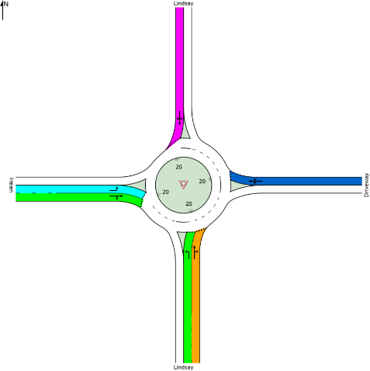
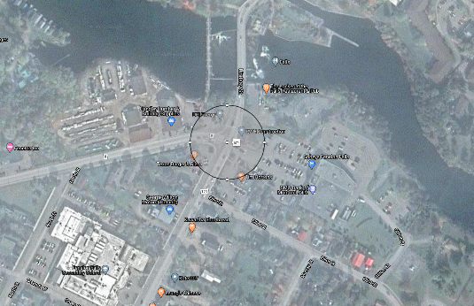

Traffic Improvements
Roundabout at Helen / Lindsay Street
Not Recommended
 | South Leg | East Leg | North Leg | West Leg | Intersection
V/C Ratio | 0.91 | 0.70 | 0.86 | 0.62 | 0.91
Roundabout alternative was evaluated
2-lane roundabout (constrained to 1 lane on North and East legs):
  Volume to capacity ratios are above design guidelines (> 85%)
  Limited space
  Property acquisition needed
46 metres
Notes:
The TAC Roundabout Design Guidelines (2017) indicate a minimum starting-point inscribed circle diameter of 46 metres (outside pavement diameter). This does not include a boulevard for snow storage, and additional space for sidewalks, lighting, signage and overhead utilities around the roundabout. This dimension also assumes that large trucks will be able to straddle lanes on roundabout entry and circulation.

Slide 17
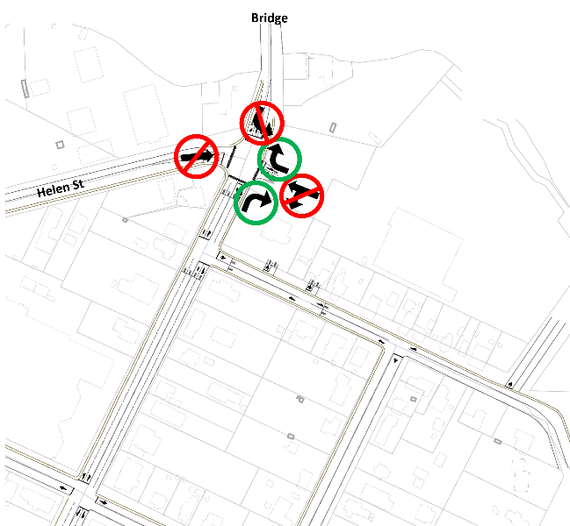
Recommended In-Town Improvement Option – Step 1
Step 1:
Change the Sobeys / Tim Hortons access via Lindsay Street to become northbound Right-in and Right-out only.
Remove the ability for southbound traffic on the bridge to turn left into the Sobeys / Tim Hortons access on Lindsay Street.
Remove the ability for vehicles to access the Sobeys / Tim Hortons by driving straight through the intersection from Helen Street.
Remove the ability for traffic to drive straight out of the Sobeys / Tim Hortons access onto Helen Street.
Remove the ability for traffic to turn left out of the Sobeys / Tim Hortons access onto Lindsay Street.
Notes:
Advantages
Improved Helen / Lindsay southbound queues
Queues are cleared each cycle
Helen / Lindsay eastbound queues
Queues are cleared each cycle
All intersection movements operate acceptably with re-routed traffic
Worst movement is at 68% of capacity (eastbound left at Helen / Lindsay)
Concerns & Mitigation
Undesirable signal spacing between Helen / Lindsay and Lindsay / Elliot
Desirable: 100 m – 150 m; we have <50 m
Mitigation: Coordinated signals
Long Northbound queues at Helen / Lindsay:
Queues can extend back beyond the Elliot / Lindsay intersection
Mitigation: Ensure vehicles are not blocking the intersection (line painting, signage)
Impact to Sobeys access
Using existing rear entrance would be longer for most trips
Mitigation: Introduce new access on Elliot (Phase 1B)

Slide 18
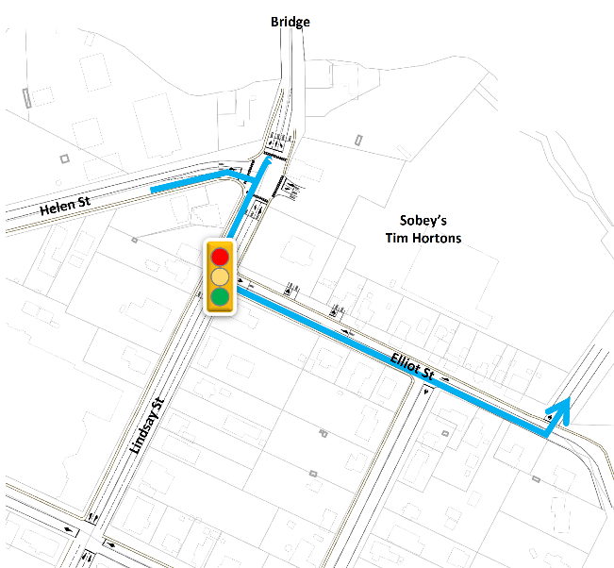
Recommended In-Town Improvement Option – Step 2
Step 2:
Put in a new light at Elliot Street.
Traffic from Helen Street and southbound on the bridge will now use Elliot Street to access the Sobeys / Tim Hortons.
Lights at Elliot Street and at Helen Street will need to be coordinated for optimal traffic flow
Notes:
Advantages
Improved Helen / Lindsay southbound queues
Queues are cleared each cycle
Helen / Lindsay eastbound queues
Queues are cleared each cycle
All intersection movements operate acceptably with re-routed traffic
Worst movement is at 68% of capacity (eastbound left at Helen / Lindsay)
Concerns & Mitigation
Undesirable signal spacing between Helen / Lindsay and Lindsay / Elliot
Desirable: 100 m – 150 m; we have <50 m
Mitigation: Coordinated signals
Long Northbound queues at Helen / Lindsay:
Queues can extend back beyond the Elliot / Lindsay intersection
Mitigation: Ensure vehicles are not blocking the intersection (line painting, signage)
Impact to Sobeys access
Using existing rear entrance would be longer for most trips
Mitigation: Introduce new access on Elliot (Phase 1B)

Slide 19
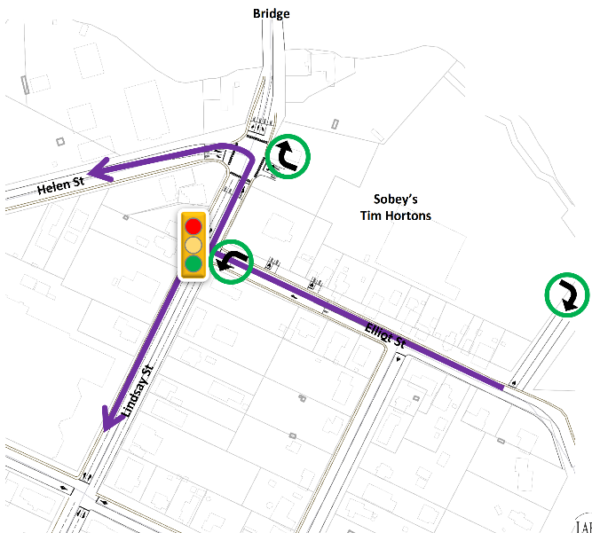
Recommended In-Town Improvement Option – Step 3
Step 3:
To exist the Sobeys / Tim Hortons vehicles use:
  the Lindsay Street exit to go north over the bridge
  Elliot Street to go west on Helen Street or south on Lindsay Street
Notes:
Advantages
Improved Helen / Lindsay southbound queues
Queues are cleared each cycle
Helen / Lindsay eastbound queues
Queues are cleared each cycle
All intersection movements operate acceptably with re-routed traffic
Worst movement is at 68% of capacity (eastbound left at Helen / Lindsay)
Concerns & Mitigation
Undesirable signal spacing between Helen / Lindsay and Lindsay / Elliot
Desirable: 100 m – 150 m; we have <50 m
Mitigation: Coordinated signals
Long Northbound queues at Helen / Lindsay:
Queues can extend back beyond the Elliot / Lindsay intersection
Mitigation: Ensure vehicles are not blocking the intersection (line painting, signage)
Impact to Sobeys access
Using existing rear entrance would be longer for most trips
Mitigation: Introduce new access on Elliot (Phase 1B)

Slide 20
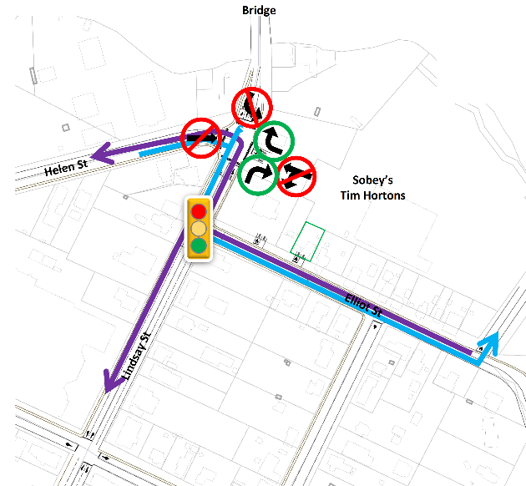
Recommended In-Town Improvement Option
Traffic Analysis Results
At the intersection of Helen Street and Lindsay Street there will now be two southbound through lanes that will get vehicles through the intersection with less green-time which allows for more green-time to be given for the eastbound left turns from Helen Street north onto the bridge.
Southbound left turns are better accommodated at Elliot Street with fewer conflicts (T-intersection) and less impact on other turning movements at Helen Street and Lindsay Street.
Requires improvements to Elliot Street
Additional improvements to this would be for Tim Hortons and/or Sobeys to acquire additional adjacent property for a new entrance on Elliot Street.
Potential to examine future Elliot Street extension.
Potential to examine future Elliot Street extension
Notes:
Advantages
Improved Helen / Lindsay southbound queues
Queues are cleared each cycle
Helen / Lindsay eastbound queues
Queues are cleared each cycle
All intersection movements operate acceptably with re-routed traffic
Worst movement is at 68% of capacity (eastbound left at Helen / Lindsay)
Concerns & Mitigation
Undesirable signal spacing between Helen / Lindsay and Lindsay / Elliot
Desirable: 100 m – 150 m; we have <50 m
Mitigation: Coordinated signals
Long Northbound queues at Helen / Lindsay:
Queues can extend back beyond the Elliot / Lindsay intersection
Mitigation: Ensure vehicles are not blocking the intersection (line painting, signage)
Impact to Sobeys access
Using existing rear entrance would be longer for most trips
Mitigation: Introduce new access on Elliot (Phase 1B)

Slide 21
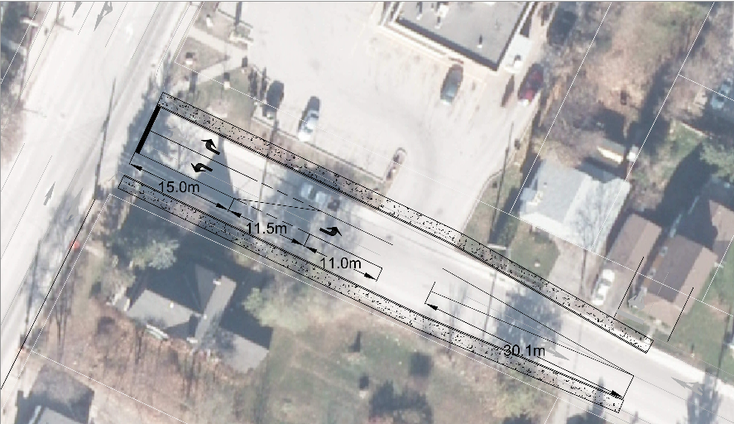
Improvements to Elliot Street
Elliot is already being planned for reconstruction
Includes improving design to allow more through traffic past the Tim Hortons entrance
Recommend improving the design to allow for a centre turn lane
Could use the majority of the centre lane (approximately 30m length) for a left queue lane to Tim Hortons. Or split with the left turn to Lindsay Street. To be confirmed in next steps.
Tim Hortons
Notes:
Recognize that there may be some improvements that could be made by Tim Horton’s to improve on-site circulation.
Address more of the Tim Horton’s traffic queueing through other options.
Beyond scope of the EA to identify.

Slide 22
Summary of Traffic Operation Improvements
Modify turning permissions at Helen and Lindsay Street related to accessing the Tim Hortons and Sobeys sites.
Add lights at Elliot and Lindsay intersection – coordinated/synchronized with Helen and Lindsay intersection signal timing.
Improve Elliot Street and rear access to Sobeys.
Provide queue lane on Elliot Street for Tim Hortons.
No further EA work required.
Design work still needed for intersection and road improvements.
Potential for additional new access location on Elliot Street in future (would require property on north side of Elliot).

Slide 23
Other Options Considered
In-Town Area
Do Nothing
Improve local traffic operations
Expand existing bridge
Build second in-town crossing
Build a bypass: 3rd Concession Baddow
  Note: Other bypass options reviewed including existing bridges Northline/Poulsom and Concession 6/Burnt River Road
Bypass Area
Notes:
Merrilees

Slide 24
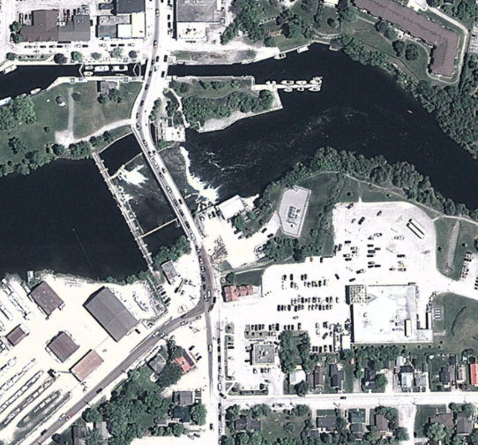
Bridge Widening
Expanding existing bridge will not solve the traffic issues:
Adding more southbound left queuing space does not improve traffic flow, the queues continue to grow.
Complications for design of Colborne Street and tie-ins with Colborne and Lindsay:
  Colborne is 2 lanes so would shift bottleneck
  Road alignment skewed, affects geometry north and south of bridge
Expanding the bridge for auto traffic is not recommended.
The existing bridge and pedestrian connection does require improvements/rehabilitation. Includes improved pedestrian connections on both sides of the bridge.
Notes:
2031 traffic volumes cannot be accommodated:
The additional lane would be used for storing southbound left turning vehicles accessing the Tim Horton’s/Sobeys driveway, and would not provide additional through-vehicle capacity
This will not provide a solution to the growing queues in the southbound lanes – queues are still continuously growing.
If time is allocated to the southbound movement to clear the queues, the eastbound and westbound movements experience significant growing queues.
The intersection will not operate acceptably if southbound queues are mitigated.

Slide 25
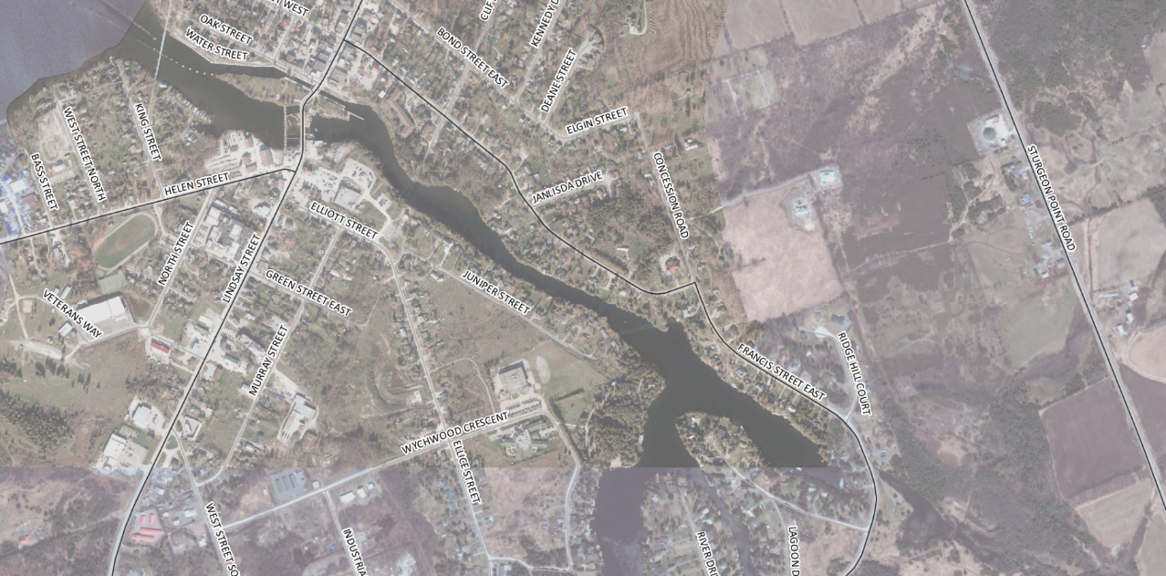


New In-Town Crossing
A
B
C
Notes:
Looked at Clifton but not carried forward.

Slide 26
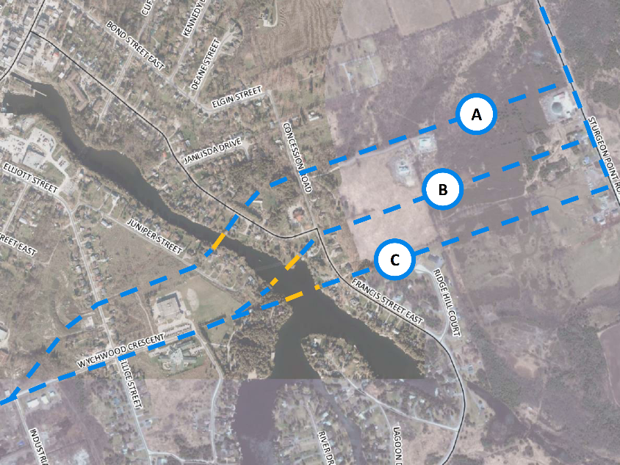
In-Town Bridge Crossing
A new in-town bridge crossing would:
Require new road connections on both sides of the waterway
Likely needs two bridges/overpass due to grades and elevation of Francis
Multiple impacts to properties, environment and existing communities
Highest cost of all options ($15-$20M estimate)
Provide greatest relief to existing traffic concerns
Not recommended as an immediate solution. Need does not justify scale of solution. Recommend future review as growth is confirmed.
Not Recommended – impacts and cost outweigh benefits. If a large new development in town were to be approved in future (e.g. Fenelon Trails), this option could be reconsidered.

Slide 27
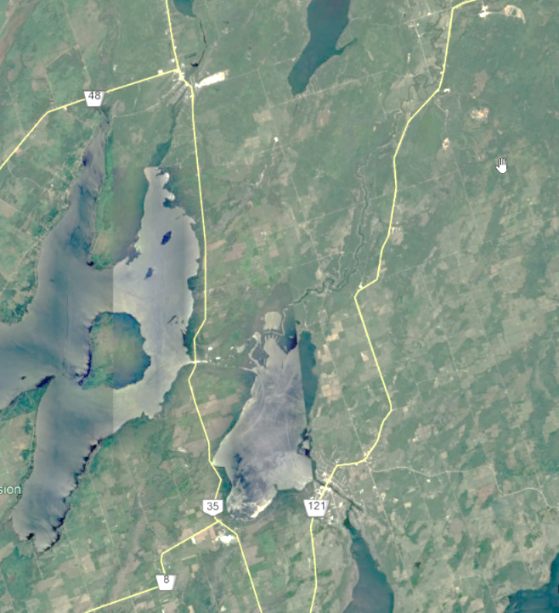
Bypass Crossing
Existing Concession 6
Considerations:
Connecting Hwy 35 to 121 north of Rosedale
Existing connections are not direct and are not currently suitable as haul routes
Haul Route identification:
  3rd Concession with new bridge previously identified in Aggregate Haul Route Study (2006)
  Looked at existing and new routes
There are options to increase signage to direct bypass traffic to existing routes
  Interim recommendation could include improving signage to access Mitchells Bridge on Northline
New Concession 3
Existing North Line
Fenelon Falls

Slide 28
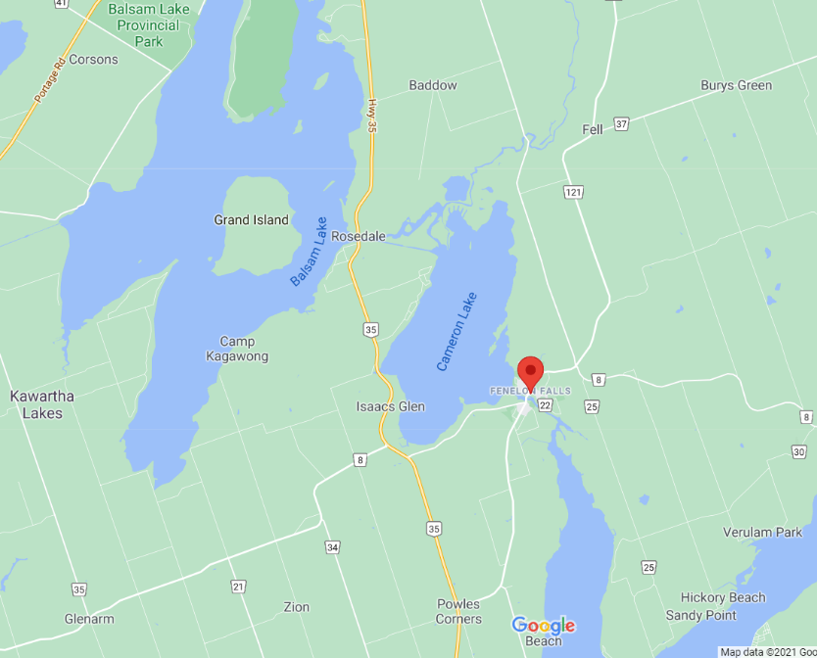
Bypass Vehicle Diversion
Northeast (NE)
Potential Vehicle Diversion
Average Summer Day (24hrs)
Streetlight Data assessment of Users on Fenelon Falls Bridge
Travel Pattern that Bypass would address is SW to NE
(31% of vehicles on Bridge)
Served by 3rd Concession more directly
Key travel pattern for quarry and heavy vehicles
Northline (Mitchells Bridge) not direct, turns will reduce truck use and require all intersections to be improved and road upgrades
Assume a portion of users likely to divert around Fenelon via Bypass, not all 31%
Southwest (SW)

Slide 29
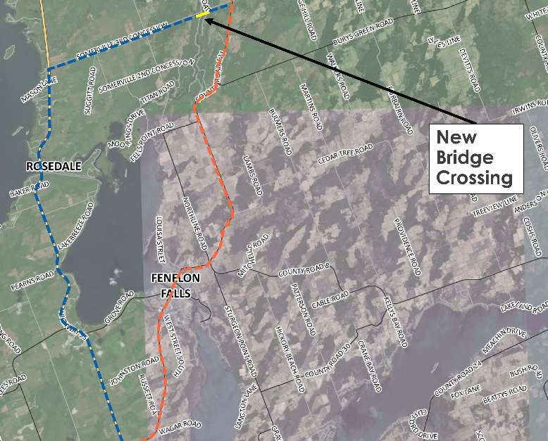
Bypass Crossing
Summary:
Multiple impacts to properties, environment and existing communities (less than in-town)
Requires study on upgrades needed for existing roads, property requirements, maintaining ATV connection, boat launch, and environmental impacts
Requires further review of bridge design considerations
Mid-level cost compared to other options ($6-9M estimate)
Relief to existing traffic concerns, particularly trucks
Redirect 20% of traffic around town

Slide 30
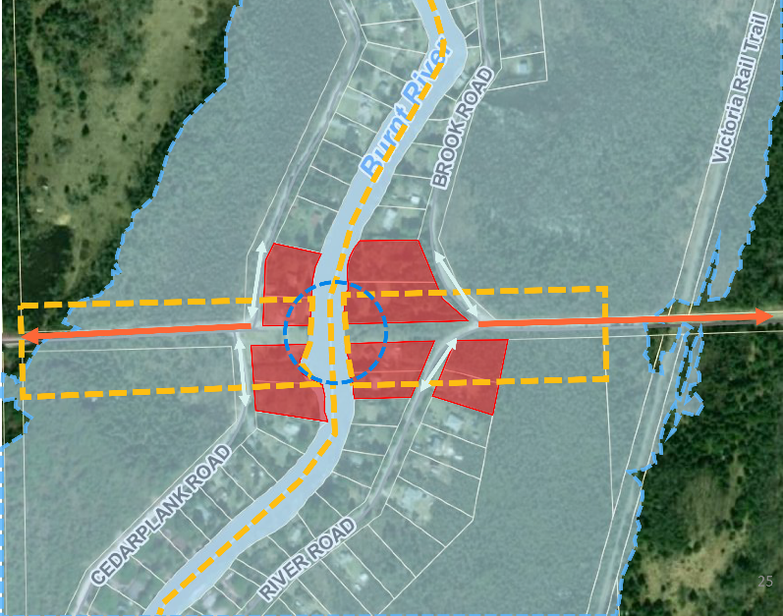
Issues to Address with Bypass
  There is no low impact option. The bypass has issues that need further study before recommending:
Property Impacts: private property, boat launch
Natural Environment: Burnt River, wildlife habitat (terrestrial, aquatic)
Noise / Air Quality: Entirety of 3rd Concession and properties along Burnt River
Boating: Navigable water clearances and launch access
Road Connections: Access to connecting routes, grading, sightlines
Flood Plain: Minimizing impact

Slide 31
High Level Cost Comparison
In-Town: Most Expensive option (1.5 – 2 times more expensive than by-pass. Tens of millions.)
  Road reconstruction, bridge construction, property easements (25-30) and property acquisition (9-10).
Bypass: Less Expensive than In-Town crossings
  Road reconstruction, bridge construction, property easements (30-35) and property acquisition (4-6)
Traffic Improvements: Least Expensive option (range of relatively low cost improvements)
Notes:
Road Information
Road Length
2.02 km
2.4 km
2.12 km
6.85 km
Number of intersections
6
6
6
2
Bridge Information
Bridge Length
110 m
140 m
184 m
92 m
Anticipated Cost
~$7m
~$11m
~$14.5m
~$4.5m

Slide 32
What We’ve Heard
  Consultation to date:
  Two Public Information Centres (May 27, 2019 & November 6, 2019)
  Two Stakeholder Meetings (September 30, 2019, August 5, 2020)
  One Committee of the Whole Presentation (November 3, 2020)
  We’ve Heard Concerns about previous meeting notifications. Notices were provided to properties in areas of potential impact. Recognize concerns that property owners may have missed the notices. This is not the end of consultation. For either a new bypass or a second in-town bridge, further study and consultation is required. The work to date is not sufficient to make a recommendation for implementation of either a new bypass or second in-town bridge.

Slide 33
What We’ve Heard
Through consultation to date we’ve heard:
  Mixed support for solutions – wide range of opinions
  Concerns with impacts to residents and environment for a new bridge in-town or a bypass (noise, air quality, wildlife, flooding, road safety, recreation, property values, etc.)
  Concerns with changes to Helen Street and Lindsay Street intersection and increased use of Elliot Street
  Concerns with Tim Hortons traffic and drive-through queueing
  Desire to see the existing bridge improved
  Interest to see options that better utilize existing Burnt River bridges (Mitchells Bridge on Northline in particular)
  Concern for EMS response issues – these have not been identified by the providers themselves, more a community perspective and concern
  Interest to see more study/progress on a future second bridge in-town, be ready for growth

Slide 34
Recommendations
Further study of the Bypass Solution to assess impacts and bridge options
  Schedule C MCEA work is needed for the bypass to assess impacts in more detail and consider design requirements
  Currently not a recommendation to build the bypass. Further work required.
Implement traffic improvements for Helen Street, Lindsay Street and Elliot Street
  Monitor traffic once these improvements are made before implementation of other solutions
Complete existing bridge rehabilitation and improve the pedestrian connections
Work with Tim Hortons on drive-through traffic issues and potential options for on-site improvements, access improvements or overall relocation.
Continue to monitor growth in Fenelon Falls that would support the need for a second bridge in-town. Consider/study long term impacts of COVID on population growth and travel patterns.
Review signage for Mitchells Bridge (Northline) Route.

Slide 35
Next Steps
Submit comments by June 15, 2021
Post FAQ on project Website based on questions received by July 15, 2021
Provide summary report to Council
  Recommendations and direction to be confirmed by Council
Martin Sadowski
Sr. Engineering Technician
City of Kawartha Lakes
Email: msadowski@kawarthalakes.ca
Merrilees Willemse
Environmental Planner
Dillon Consulting
Email: mwillemse@dillon.ca
Notes:
Road Information
Road Length
2.02 km
2.4 km
2.12 km
6.85 km
Number of intersections
6
6
6
2
Bridge Information
Bridge Length
110 m
140 m
184 m
92 m
Anticipated Cost
~$7m
~$11m
~$14.5m
~$4.5m

Slide 36
Questions

